Slide 1
Working from the Home Environment & Well-Being Study Data
Project Motivation: To know the health effects of working from home because it is valuable for both the company and the individual.
Project Goal: Analyze the effects, both physically and mentally, of remote work over a long period of time (6 months). Key Hypotheses Tackled:
Hypothesis: Participants who have an average of 3 locations per week will have higher stress algorithms than people who use an average of 4 or more locations per week.
Hypothesis: Participants who take an average of 2 or fewer breaks per day will report more pain and less comfort than those who take an average of 4 or more breaks per day.
Project Background: Certain teams have already gone fully remote while many have gone fully hybrid. We will be working with daily surveys and Garmin Watch data to conduct our analysis.
Sponsor:College of Health and Rehabilitation Sciences: Sargent College
Team Members: Rahul Razdan, Jiang Du, Ying Han Dai, Anish Warty

Slide 2
Data Collection and Preprocessing
Data Used
Preprocessing Techniques
Daily Surveys (AM, PM, END)
Used to calculate number of breaks
Used to calculate number of locations
Used to extract Pain Values
Weekly Surveys on Fridays (AM, PM, END)
Used to calculate number of breaks
Used to calculate number of locations
Used to extract Pain Values
Garmin Watch Data
Used to get Stress Data
Six Month Data was used
Discarded NaN Values
Created Extra Columns to group data into weekly buckets for each individual (used for Hypothesis 2)
Challenges Faced
Difficulty handling all of the NaN values as there were many
Sheer amount of data made it difficult to choose what to use.
Amount of data in Garmin caused excessively slow runtimes for preprocessing.

Slide 3
Analysis Methods
Data Preprocessing (as discussed in previous slide)
Outlier Analysis
K-Means and Disagreement Distance
Hypothesis Testing
Welch T-Test
F One-Way Test

Slide 4
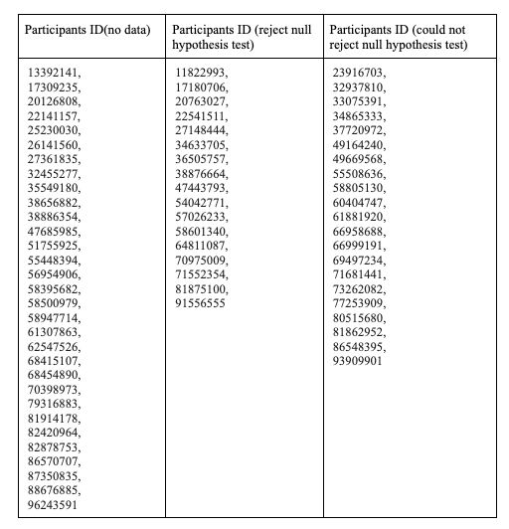
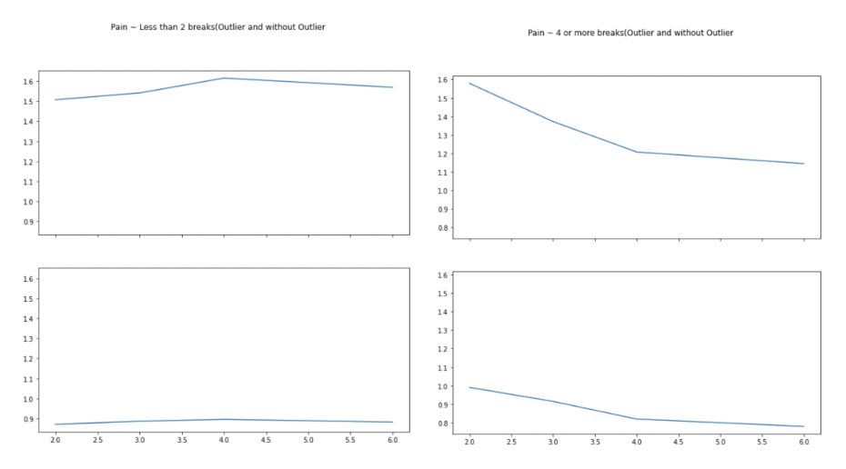
Results (Hypothesis 3)
Statistically significant Individuals

Slide 5
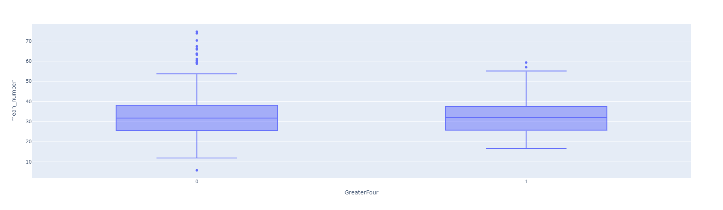
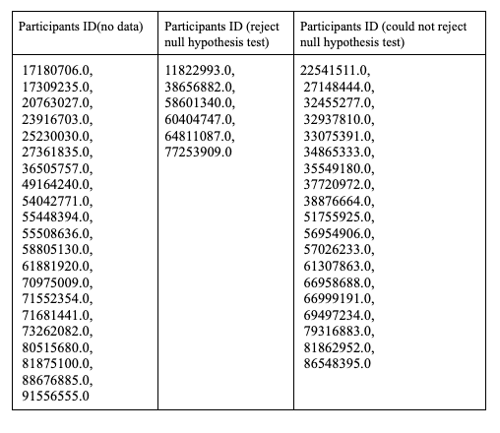
Results (Hypothesis 2)
Top Image: t-test results
Bottom Image: Statistically significant Individuals
Box-and-whisker Plots for less than or equal to three locations and more than three locations vs Stress

Slide 6
Conclusions and Next Steps
Hypothesis 2
It was not statistically significant that the number of locations affected stress
Certain individuals were statistically significant
Hypothesis 3
It was not statistically significant that the number of breaks affected pain
Certain individuals were more likely to reject the null hypothesis
Next Steps
Potentially combine number of locations and number of breaks to see if that has an effect on stress
Potentially find better ways to handle missing data to have even more data

Slide 7

We are open to take questions now!

